Slide 1


Saritha Anand
4/5/2025

Slide 2

Outline
Executive Summary
Introduction
Methodology
Results
Conclusion
Appendix

Slide 3
Executive Summary
Summary of methodologies
Data Collection through API
Data Collection with Web Scraping
Data Wrangling - Analyze using SQL
Analyze with Data Visualization
Interactive Visual Analytics with Folium
Machine Learning Prediction
Summary of all results
Exploratory Data Analysis result
Predictive Analytics result

Slide 4
Introduction
Project background and context
With commercialization of space travel, many companies are forging into delivery of space flights. In an effort to compete with such companies, develop a strategy using public information to train a machine learning model and use the best model to predict if SpaceX will reduce cost per launch by reusing the first stage of the rockets.
Problems you want to find answers
Find the best combination of launch site, orbit, booster version, landing pad and payload to enable successful landings and prevent product loss from ineffective retrieval of re-suable Stage 1 component.

Slide 5

Section 1

Slide 6
Methodology
Executive Summary
Data collection methodology:
SpaceX launch data was extracted from the SpaceX REST API and through Web scraping from SPACEX related Wiki pages to retrieve tabular data from HTML tables
Perform data wrangling
Identify columns, data types and unique values. The data was filtered to include only Falcon 9 launches and null values handled for applicable columns. Create a new column to label landing outcomes as a success or failure
Perform exploratory data analysis (EDA) using visualization and SQL
Using the modified final data set, develop and analyze basic attributes and measures to understand the launch sites, launch types and the landing types and their correlation with landing outcome of success or failure
Perform interactive visual analytics using Folium and Plotly Dash
Build a dashboard to give users the ability to view performance metrics for the different launch sites
Perform predictive analysis using classification models
Use different supervised machine learning models – Linear Regression, SVM,K nearest neighbors and Random Forest to compare prediction accuracy for test data set and recommend the best model for evaluation and deployment

Slide 7
Data Collection
SpaceX launch data was extracted from the SpaceX REST API and through Web scraping from SPACEX related Wiki pages to retrieve tabular data from HTML tables
Data Sources :
REST API: https://api.spacexdata.com/v4/rockets/
Web scraping: https://en.wikipedia.org/w/index.php?title=List_of_Falcon_9_and_Falcon_Heavy_launches&oldid=1027686922

Slide 8
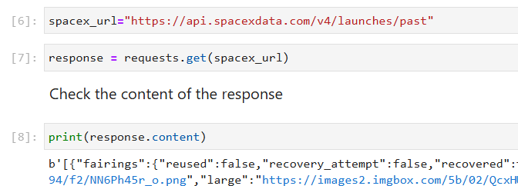
Data Collection – SpaceX API
https://github.com/saritha2/Course-10--Applied-Data-Science-Capstone-/blob/main/jupyter-labs-spacex-data-collection-api.ipynb
Save final datafarme as csv file
>get request to SpaceX API for all past launch activity
>decode the response content as a Json using .json()
> for each rocket obtain additional attributes like booster name. launch site lat/long , Orbit,LandingPad, cores using helper functions
Refine the dataframe to include Falcon 9 Boosters only
Identify column data types and null values (2 columns have multiple null values - determine if the missing values needs to be addressed)
>convert into a Pandas dataframe using json_normalize()
> stored as lists > build a dictionary with all columns
>create a new Pandas data frame from the dictionary
> reset Flight Number respective to Falcon 9 booster data only
>Payload nulls replaced with mean Payload mass value

Slide 9
Data Collection - Scraping
Course-10--Applied-Data-Science-Capstone-/jupyter-labs-webscraping.ipynb at main · saritha2/Course-10--Applied-Data-Science-Capstone-
>perform an HTTP GET method to request the Falcon9 Launch HTML page, as an HTTP response
>create an empty dictionary with keys from the extracted column
>extract each column (using provided functions to address data inconsistencies)
>load into the empty dict
>create the launch dataframe
> Use BeautifulSoup to extract column/variable names from the relevant HTML table header(Table 3)

Slide 10
Data Wrangling
Course-10--Applied-Data-Science-Capstone-/labs-jupyter-spacex-Data wrangling.ipynb at main · saritha2/Course-10--Applied-Data-Science-Capstone-
>Load created dataframe
>Identify and calculate the percentage of the missing values in each attribute
>Identify column datatypes
Use the method .value_counts() to determine >the number of launches on each site
> the number and occurrence of each orbit
>the number of landing_outcomes
> Create a landing outcome label from Outcome column (success – 1, failures-0(set of bad outcomes))
>Calculate success rate as mean of the outcome label.

Slide 11
EDA with Data Visualization
Course-10--Applied-Data-Science-Capstone-/edadataviz.ipynb at main · saritha2/Course-10--Applied-Data-Science-Capstone-
Analyze the data to identify features and their effect on flight performance.
Scatterplots to visualize the relation between
FlightNumber and PayloadMass
Flight Number and Launch Site
Payload and Launch Site
Flight Number and Orbit
Payload Mass and Orbit
Launch Site and Orbit
Use bar charts to identify which orbits have the highest success rates and line chart to see yearly success trends for the Falcon 9 launches.

Slide 12
EDA with SQL
Course-10--Applied-Data-Science-Capstone-/jupyter-labs-eda-sql-coursera_sqllite.ipynb at main · saritha2/Course-10--Applied-Data-Science-Capstone-
Use SQL queries and subqueries to list
names of the unique launch sites in the space mission
total payload mass carried by boosters launched by NASA (CRS)
average payload mass carried by booster version F9 v1.1
date when the first successful landing outcome in ground pad was achieved.
names of the boosters which have success in drone ship and have payload mass greater than 4000 but less than 6000
total number of successful and failure mission outcomes
the booster_versions that have carried the maximum payload mass
failure landing_outcomes in drone ship ,booster versions, launch_site for every month in year 2015.
Summarize landing outcomes (such as Failure (drone ship) or Success (ground pad)) between the date 2010-06-04 and 2017-03-20, in descending order.

Slide 13
Build an Interactive Map with Folium
To find some geographical patterns about launch sites.
With NASA Johnson Space Center at Houston, Texas as anchor, use lat/long of each site to display them as a red circle on the map
For each site, add successful launch outcomes counts as green marker and red marker for failed landings, and see which sites have high success rates.
Explore and analyze the proximities of launch sites with lines connecting launch site to closest coastline, railway track, highway and metro/city.
From the visuals, it appears launch sites are close to coastlines, railway and highways (due to ease of logistics) and away from populated cities( for safety)
Course-10--Applied-Data-Science-Capstone-/lab_jupyter_launch_site_location.ipynb at main · saritha2/Course-10--Applied-Data-Science-Capstone-

Slide 14
Build a Dashboard with Plotly Dash
App for users to perform interactive visual analytics on SpaceX launch data in real-time.
This dashboard application contains input components such as a dropdown list and a range slider to interact with a pie chart and a scatter point chart
Enables users to obtain some insights on the largest successful launches, success rate specifics by launch site, payload range and Booster version
Course-10--Applied-Data-Science-Capstone-/spacex-dash-app.py at main · saritha2/Course-10--Applied-Data-Science-Capstone-

Slide 15
Predictive Analysis (Classification)
To develop the best prediction model, the steps included
Course-10--Applied-Data-Science-Capstone-/SpaceX_Machine Learning Prediction_Part_5.ipynb at main · saritha2/Course-10--Applied-Data-Science-Capstone-
Load data
Create NumPy array from the column Class (Predictor variable Y as Panda Series)
Standardize the independent variable data using the StandardScaler and then fit and transform the standardized data
split the data into training and testing data using the function train_test_split. The training data is divided into validation data, a second set used for training data; then the models are trained and hyperparameters are selected using the function GridSearchCV
4 different models were used – LinearRegression,Support Vector Machine Classification, ClassifierTree and K-Nearest Neighbors. For each of these models,the best parameters were identified using the data attribute best_params_ and the accuracy on the validation data using the data attribute best_score_.
For each model, its accuracy on the test data was calculated using the method score.
The y-hat values were presented as a confusion matrix to display the true positives and false positives.
While all 4 models identified the true positives correctly, SVM showed the highest accuracy score and had the lowest false positives.

Slide 16
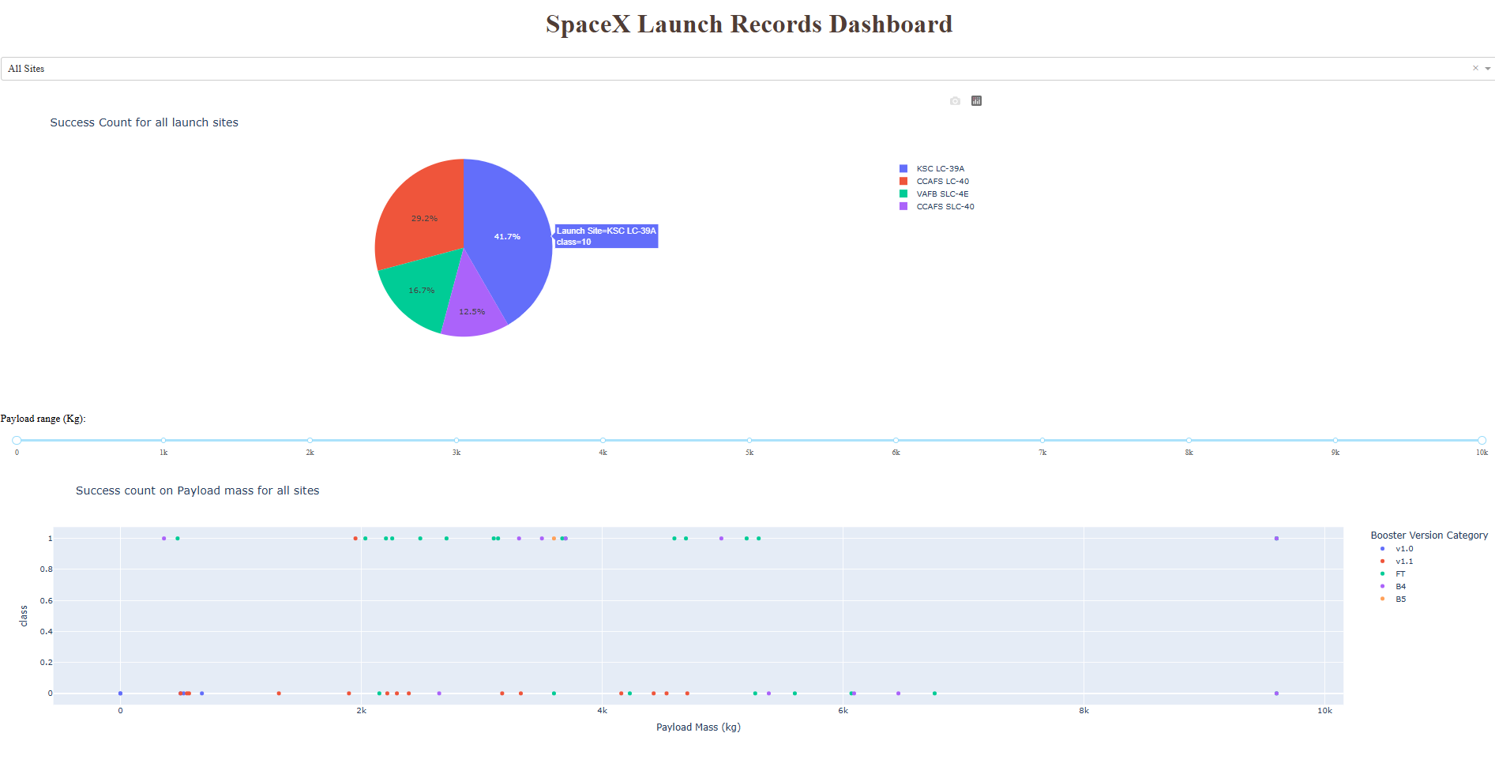
Results
Exploratory data analysis results
As the flight number increases, the first stage is more likely to land successfully. The payload mass also appears to be a factor; even with more massive payloads, the first stage often returns successfully.
With all three Launch sites (CCAFS SLC 40 , VAFB SLC 4E, KSC LC 39A) , the number of successes were not greatly increased with the increase in flight numbers but there seemed to be a weak relation between the 2 variables.
Of two of three Launch sites (CCAFS SLC 40, KSC LC 39A) , the number of successes were higher with increased payloads but there was no data for , VAFB SLC 4E for payload > 10000 kg.
Success rates differed widely between orbits with GTO,ISS,VLEO having the most successes.
LEO orbit, success seems to be related to the number of flights. Conversely, in the GTO orbit, there appears to be no relationship between flight number and success.
With heavy payloads the successful landing or positive landing rate are more for Polar, LEO and ISS.
However, for GTO, it's difficult to distinguish between successful and unsuccessful landings as both outcomes are present.
Success rate since 2013 kept increasing till 2020
Interactive analytics demo in screenshots
Predictive analysis results
Model Linear Regression had an accuracy score of 83.33%,
Model SVM had an accuracy score of 94.44%
Model ClassifierTree had an accuracy score of , 83.33%
Model K nearest neighbors had an accuracy score of 83.33%

Slide 17

Section 2

Slide 18
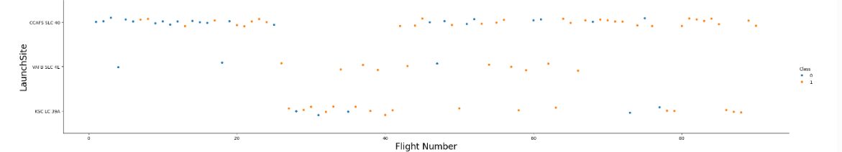
Flight Number vs. Launch Site
As the flight number increases, the first stage is more likely to land successfully. With all three Launch sites (CCAFS SLC 40 , VAFB SLC 4E, KSC LC 39A) , the number of successes were not greatly increased with the increase in flight numbers but there seemed to be a weak relation between the 2 variables.

Slide 19
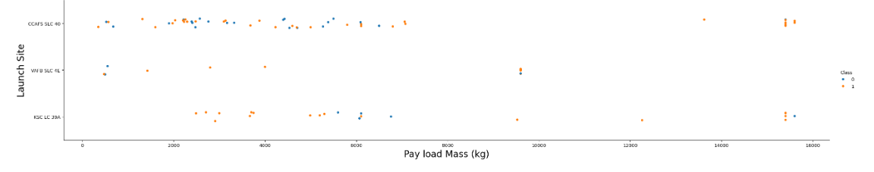
Payload vs. Launch Site
The payload mass also appears to be a factor; even with more massive payloads, the first stage often returns successfully.
Of two of three Launch sites (CCAFS SLC 40, KSC LC 39A) , the number of successes were higher with increased payloads but there was no data for , VAFB SLC 4E for payload > 10000 kg.

Slide 20
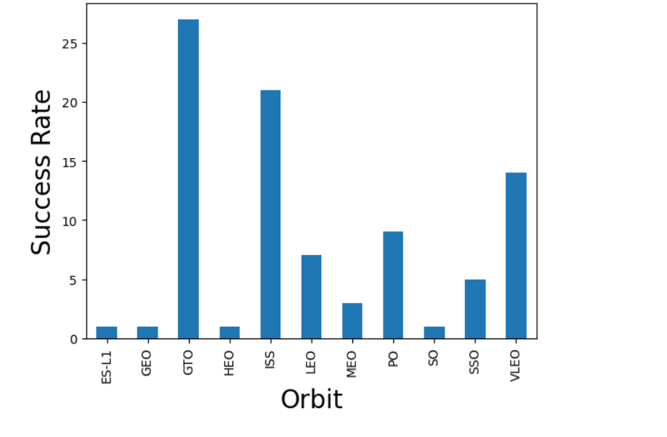
Success Rate vs. Orbit Type
Success rates differed widely between orbits with GTO,ISS,VLEO having the most successes

Slide 21
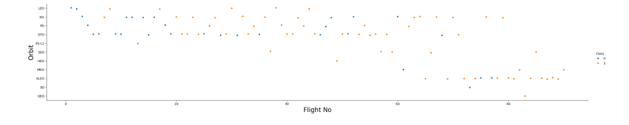
Flight Number vs. Orbit Type
LEO orbit, success seems to be related to the number of flights. Conversely, in the GTO orbit, there appears to be no relationship between flight number and success.

Slide 22
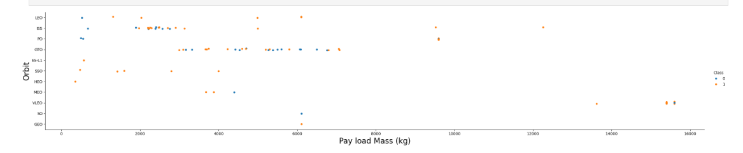
Payload vs. Orbit Type
With heavy payloads the successful landing or positive landing rate are more for Polar, LEO and ISS.However, for GTO, it's difficult to distinguish between successful and unsuccessful landings as both outcomes are present.

Slide 23
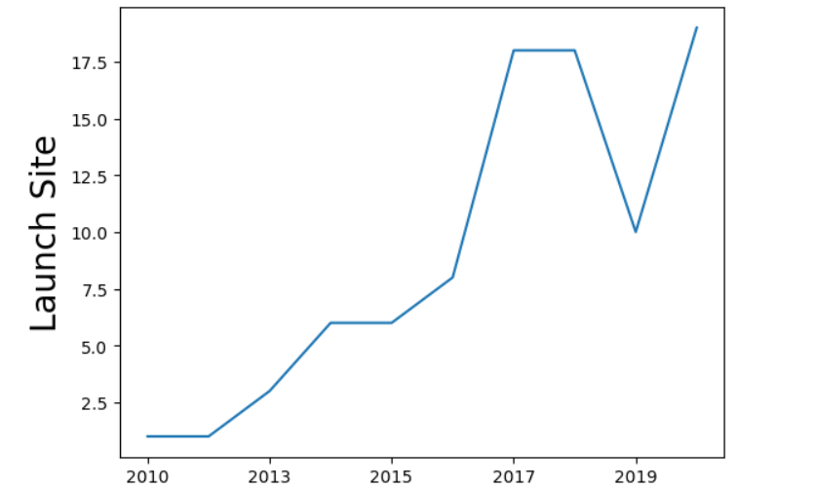
Launch Success Yearly Trend
Success rate since 2013 kept increasing till 2020

Slide 24
All Launch Site Names
There were 4 unique Launch sites.
The Launch Sites were
CCAFS LC-40
VAFB SLC-4E
KSC LC-39A
CCAFS SLC-40

Slide 25
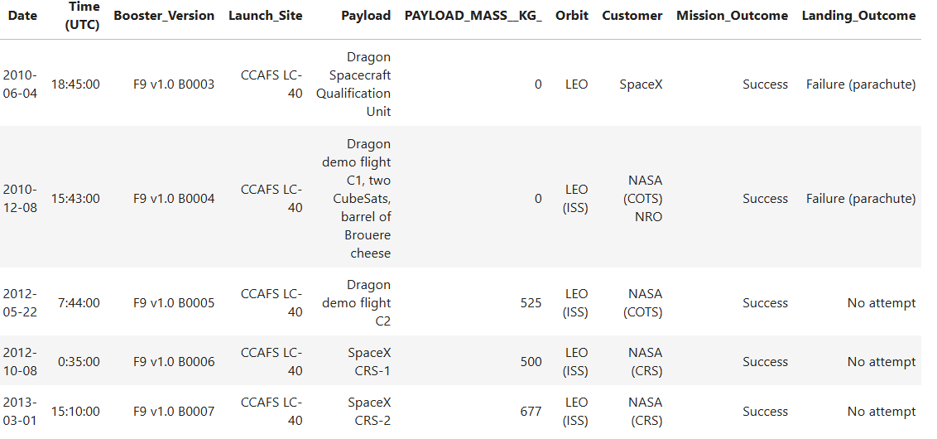
Launch Site Names Begin with 'CCA'
All 5 launches for this launch site had a successful landing and were launched to the LEO Orbit with minimal/small payloads

Slide 26
Total Payload Mass
The total payload carried by boosters from NASA was 45596 Mass/kg

Slide 27
Average Payload Mass by F9 v1.1
The average payload mass carried by booster version F9 v1.1 was 2534.6666666666665 mass/kg

Slide 28
First Successful Ground Landing Date
The first successful landing outcome on ground pad was on 2015-12-22

Slide 29
Successful Drone Ship Landing with Payload between 4000 and 6000
The following boosters successfully landed on drone ship and had payload mass greater than 4000 but less than 6000
Booster_Version
F9 FT B1022
F9 FT B1026
F9 FT B1021.2
F9 FT B1031.2

Slide 30
Total Number of Successful and Failure Mission Outcomes
The total number of successful and failure mission outcomes are
Mission_Outcome | Count
Failure (in flight) | 1
Success | 98
Success | 1
Success (payload status unclear) | 1

Slide 31
Boosters Carried Maximum Payload
The names of the booster which have carried the maximum payload mass are
Booster_Version
F9 B5 B1048.4
F9 B5 B1049.4
F9 B5 B1051.3
F9 B5 B1056.4
F9 B5 B1048.5
F9 B5 B1051.4
F9 B5 B1049.5
F9 B5 B1060.2
F9 B5 B1058.3
F9 B5 B1051.6
F9 B5 B1060.3
F9 B5 B1049.7

Slide 32
2015 Launch Records
The failed landing outcomes in drone ship, their booster versions, and launch site names for in year 2015 are
Month | Landing_Outcome | Booster_Version | Launch_Site
01 | Failure (drone ship) | F9 v1.1 B1012 | CCAFS LC-40
04 | Failure (drone ship) | F9 v1.1 B1015 | CCAFS LC-40

Slide 33
Rank Landing Outcomes Between 2010-06-04 and 2017-03-20
Landing outcomes (such as Failure (drone ship) or Success (ground pad)) between the date 2010-06-04 and 2017-03-20, ranked in descending order
Landing_Outcome | Landing_outcome_count
No attempt | 10
Success (drone ship) | 5
Failure (drone ship) | 5
Success (ground pad) | 3
Controlled (ocean) | 3
Uncontrolled (ocean) | 2
Failure (parachute) | 2
Precluded (drone ship) | 1

Slide 34

Section 3

Slide 35
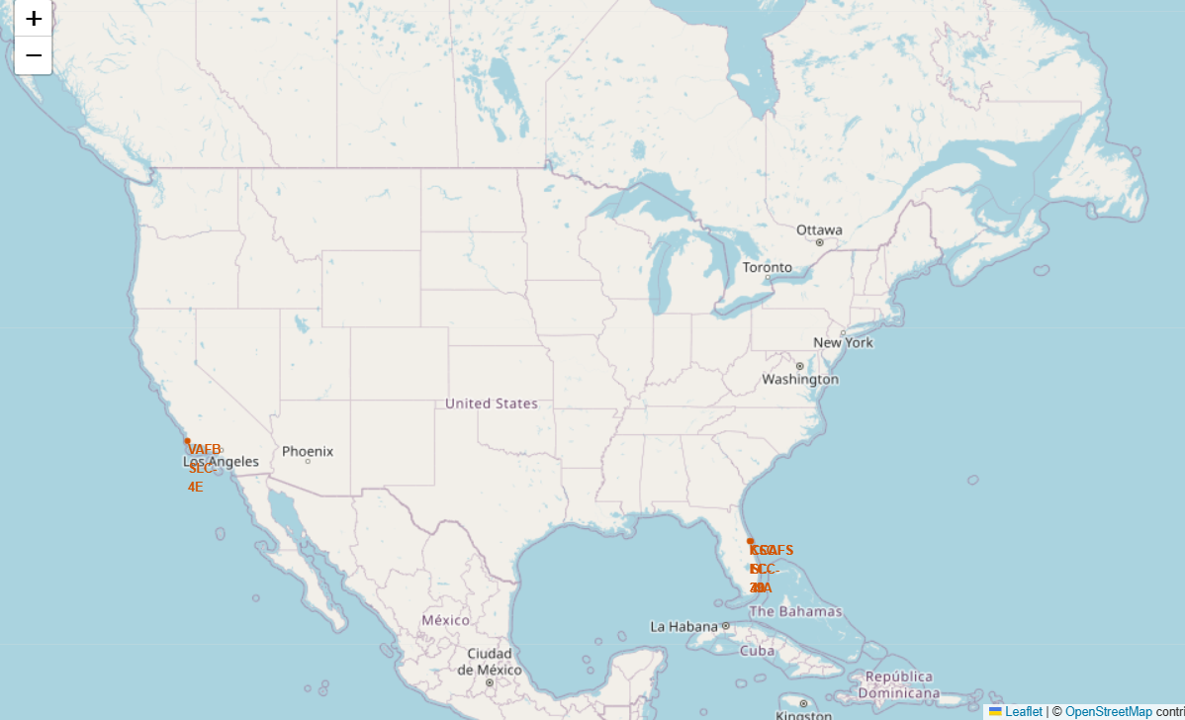
Geographic locations of Launch Sites
Launch sites are found near the coast line and are situated towards the southern part of the nation.

Slide 36
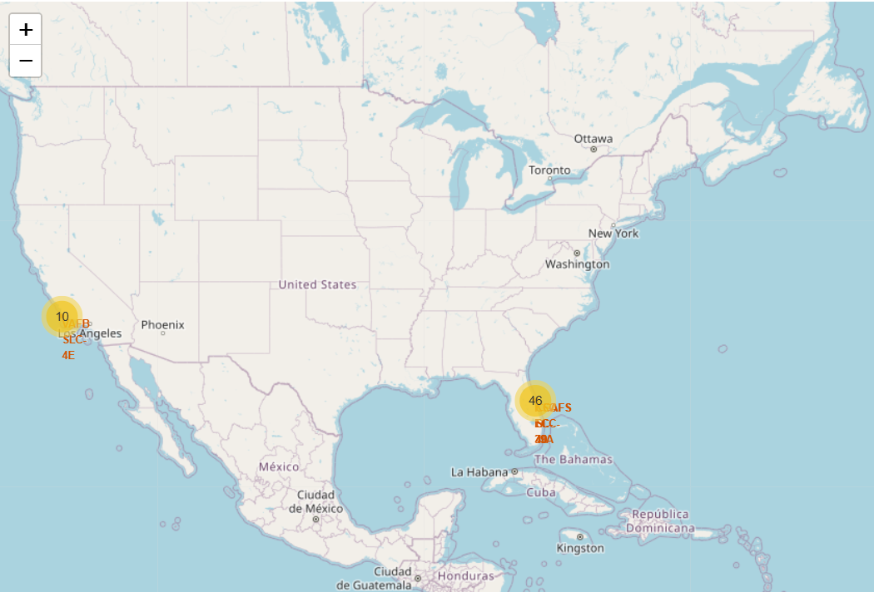
Launch Counts
There were 10 launches from VAFB SLC-4E in California and 46 from CCAFS LC-40,KSC LC-39A and CCAFS SLC-40 in Florida

Slide 37
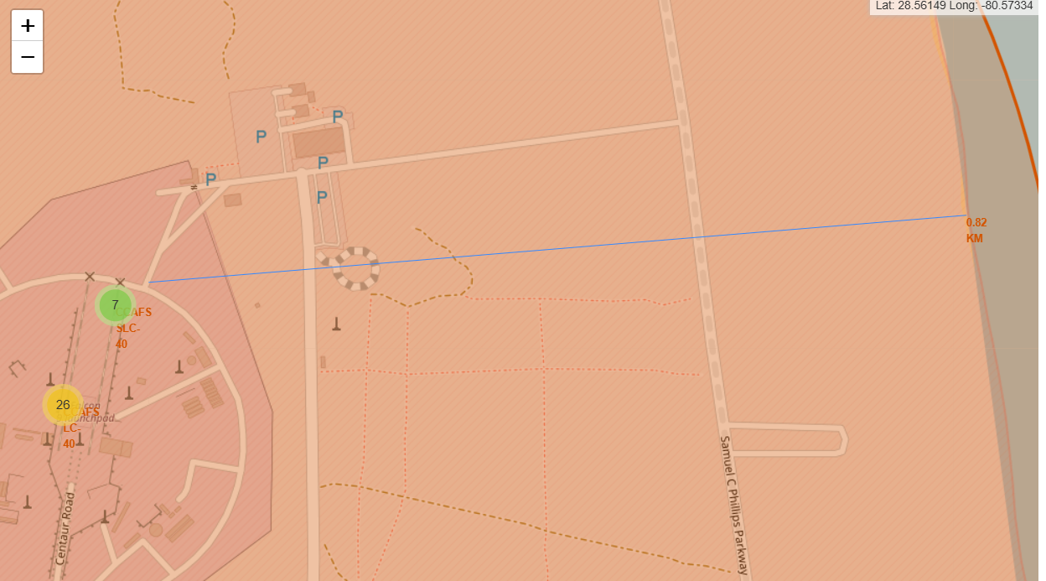
Launch Site Proximity Locations
Launch site are typically close to coastlines, railway and highways (due to ease of logistics) and away from populated cities( for safety)

Slide 38

Section 4

Slide 39
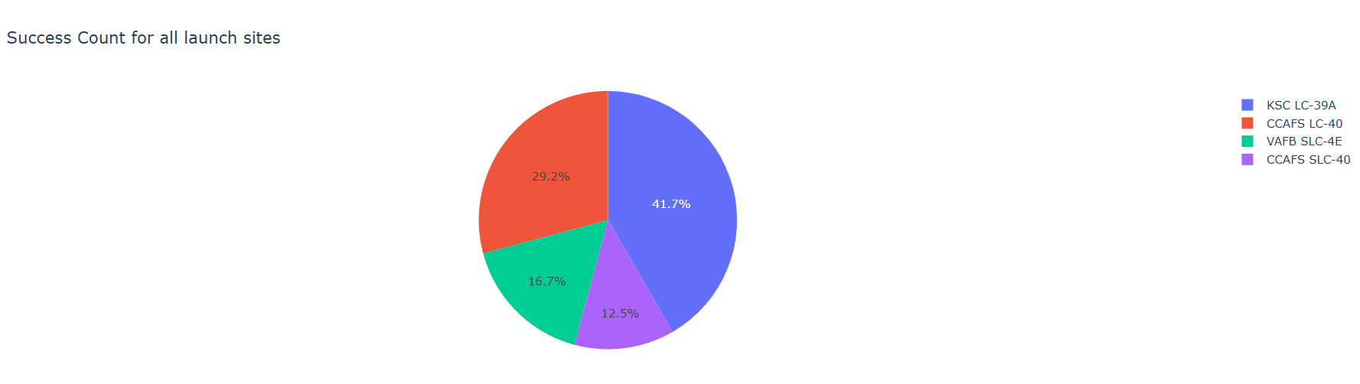
SpaceX Launch Site Successes
The launch site with the highest success was KSC LC -39A with ~42% , CCAFS LC-40 with ~30%. VAFB SLC -4E and CCAFS SLC-40 comprised the remaining 28%

Slide 40
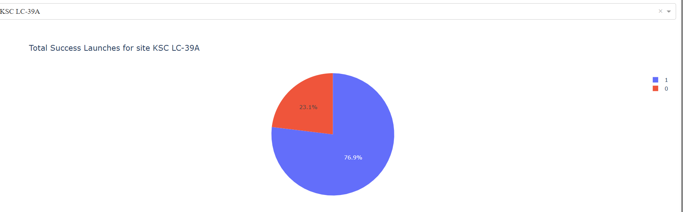
Launch Site with Highest Success Ratio
KSC LC 39A had a success ratio of ~77%

Slide 41
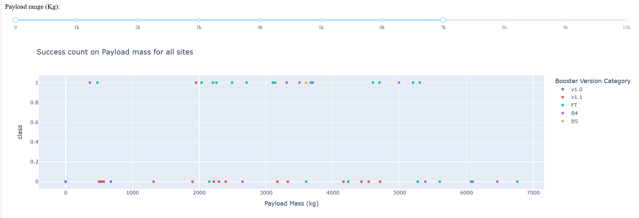
Launch Outcome by Payload Mass
For a payload mass of 7000 kg, booster version FT has the largest success rate and B4 showing more successes than other booster versions

Slide 42

Section 5

Slide 43
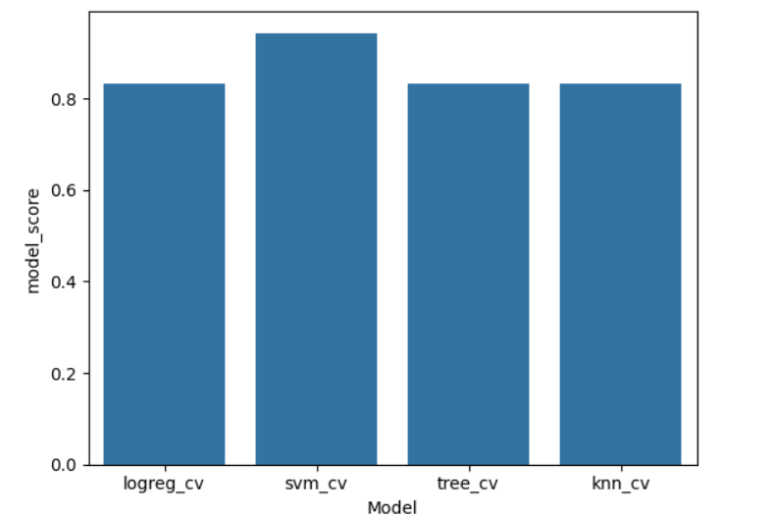
Classification Accuracy
SVM (svm_cv) model has the highest classification accuracy of 94.44%

Slide 44
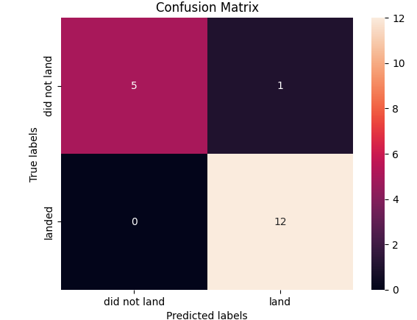
Confusion Matrix
SVM showed the highest accuracy score and had the lowest false positives.

Slide 45
Conclusions
Launch Site, Payload, Booster Version, Orbit and Flight Number were good predictors of if the stage 1 component of a SpaceX launch will land successfully
Launches between 2013 and 2020 have shown a higher success rate with 77% of launches from KSC LC 39A having a successful landing outcome
Booster versions FT and B4 have more successes than other boosters
SVC Model has the highest accuracy rate of 94% predicting true positives and reducing recalls. Hence SVM is recommended as the best model for model evaluation and deployment
Using SVM, SpaceX can predict every launch for a successful landing and therefore reuse the first stage reducing cost
and making the service competitive and sustainable

Slide 46
Appendix
Include any relevant assets like Python code snippets, SQL queries, charts, Notebook outputs, or data sets that you may have created during this project

Slide 47


